Slide 1


What’s new this year?
If you are new to the Math/STEM Adventures Program, please join us in the art room directly following our meeting in the library for more detailed program information.

Slide 2

STEM Adventures
We are renaming Math Adventures to STEM adventures and integrating new activities.
STEM Adventures (SA) is a STEM (science, technology, engineering and math) program that supports the curriculum taught at Rosa Parks and introduces students to coding.
Same as math adventures, volunteers will coordinate and pick either a math game, technology game or coding in Code.org for each session.

Slide 3
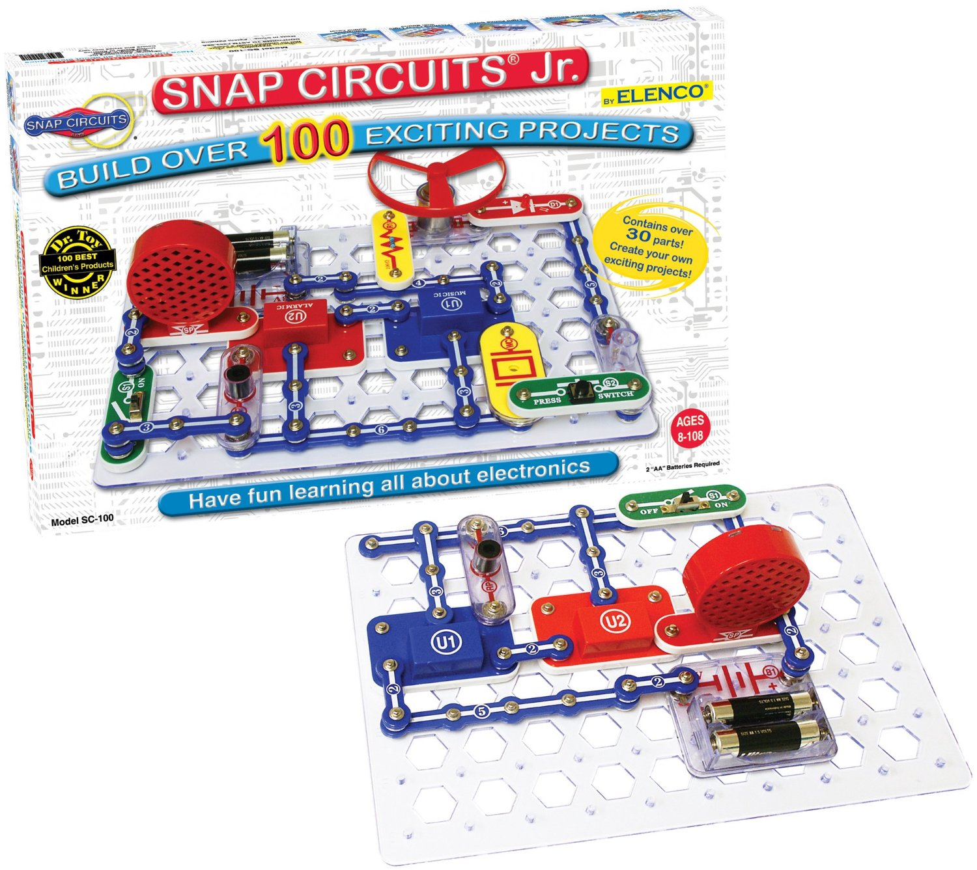
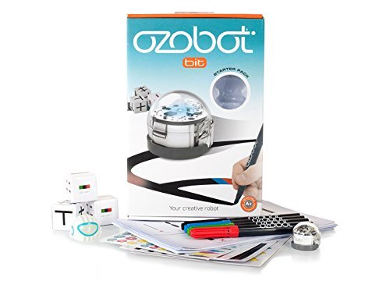
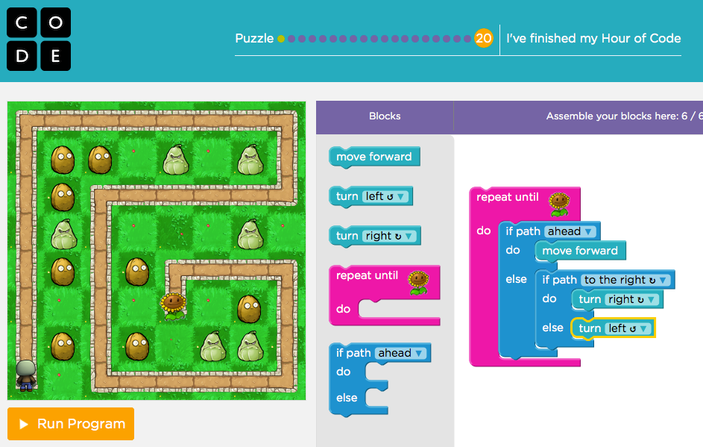
New STEM games:
(In cabinet by window)
Science Ninjas: Valence
Lattice
Sums In Space
Ozobots
Snap Circuits Jr.
Robot Turtles
Code Monkey Island
Code Master
Code.org

Slide 4
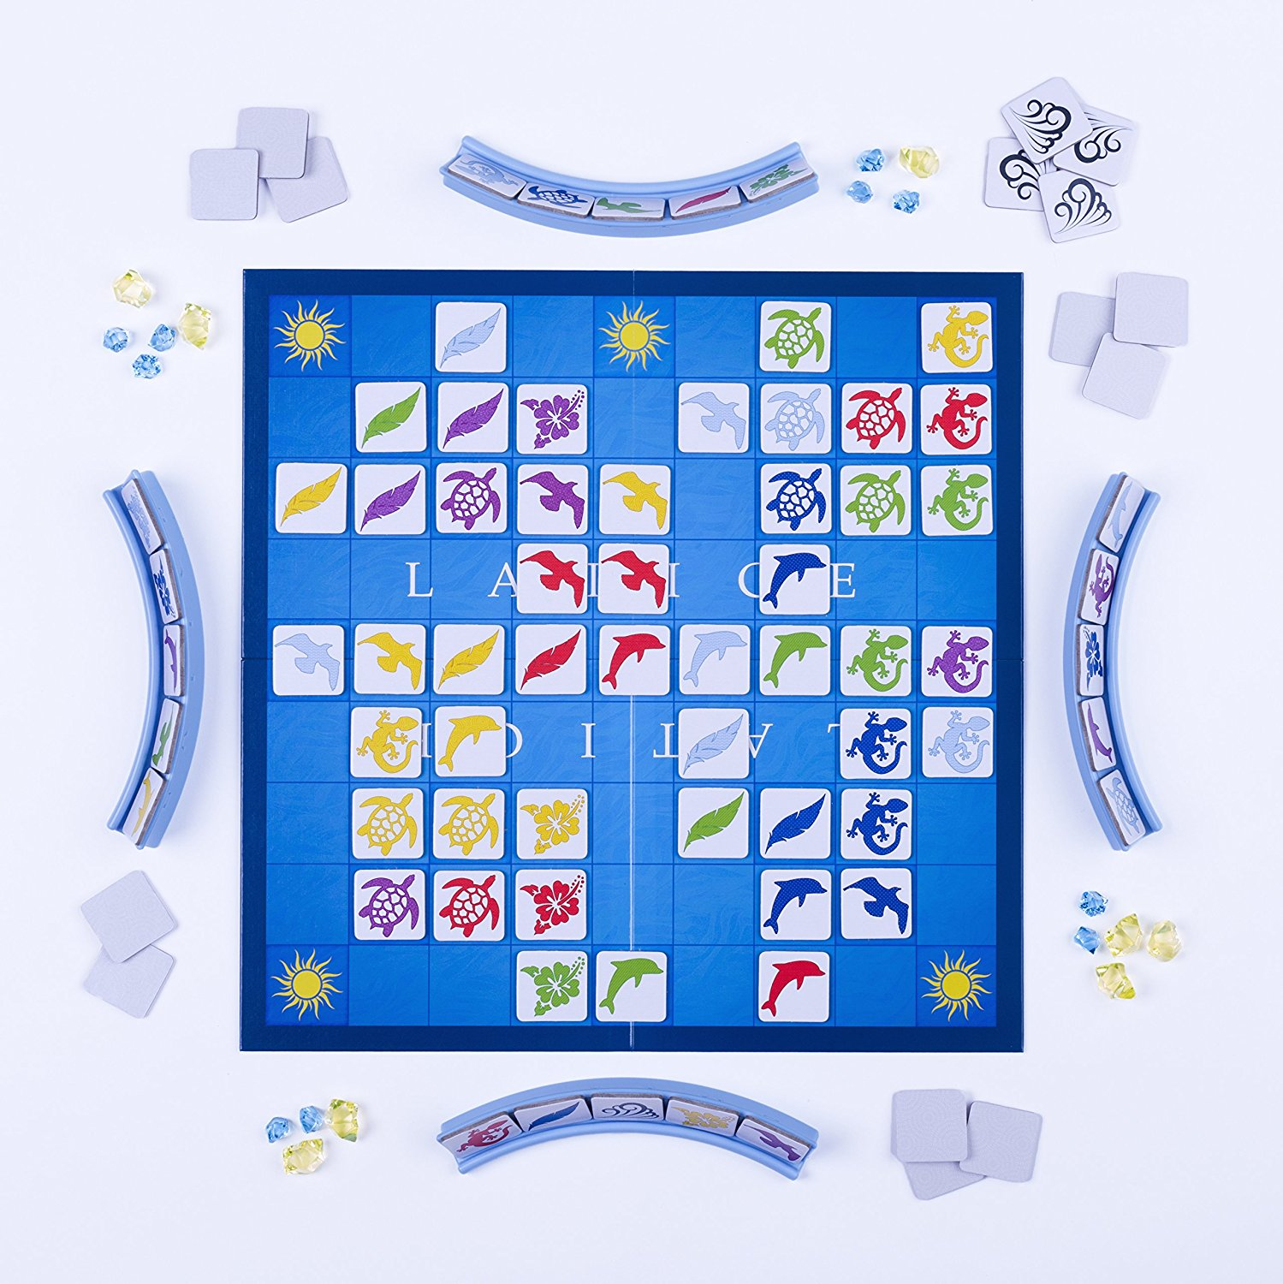
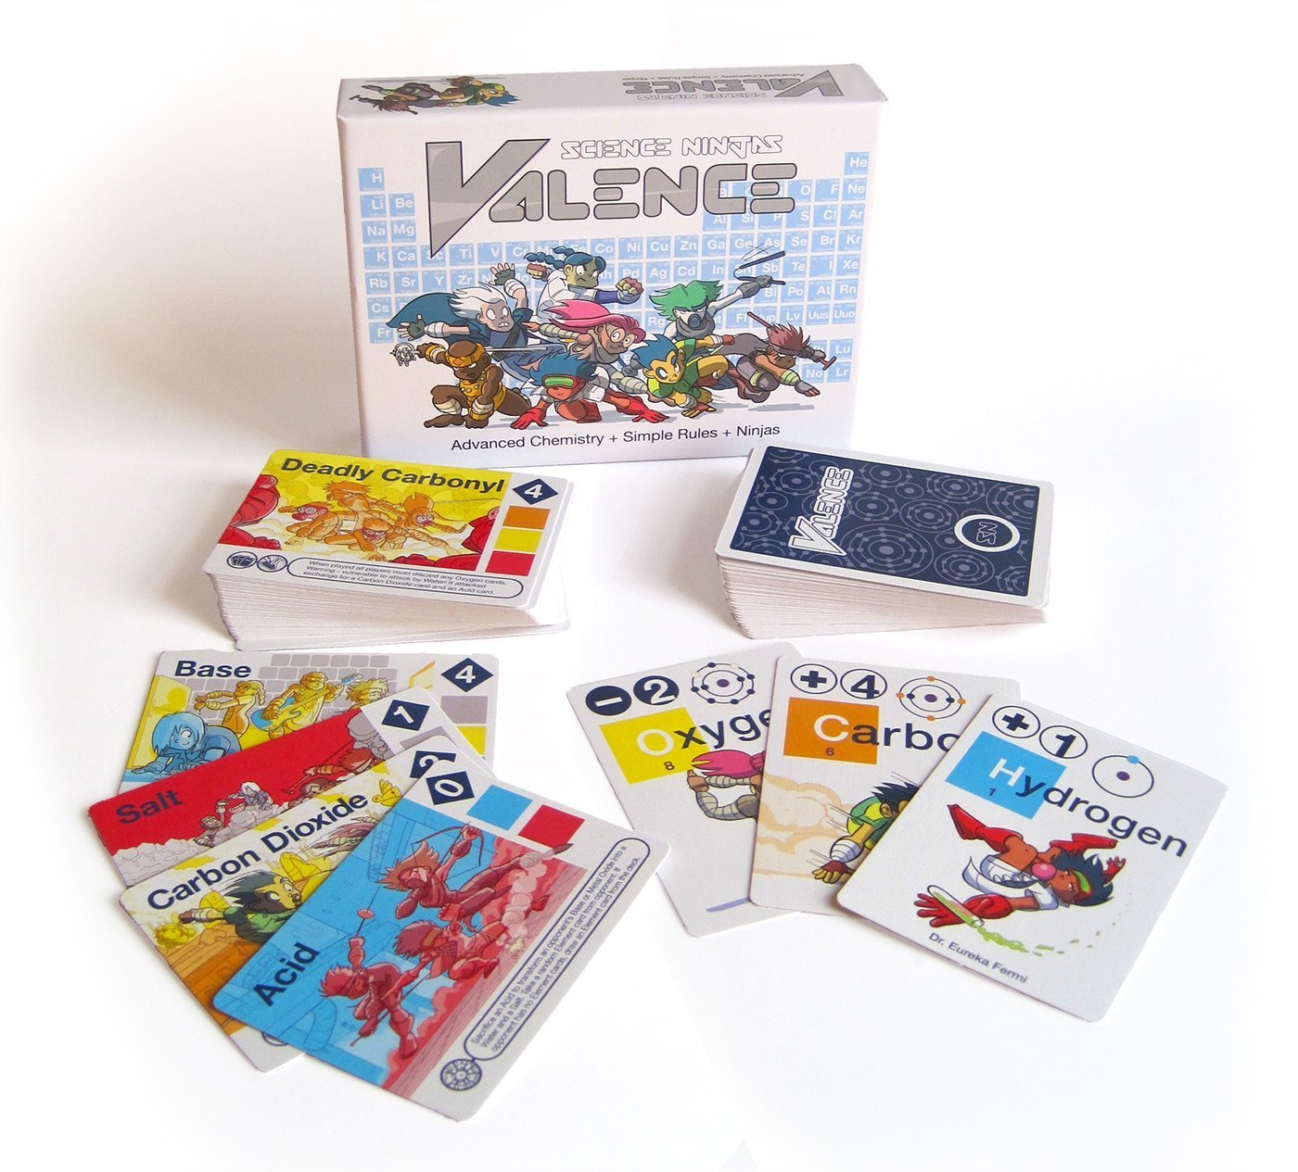
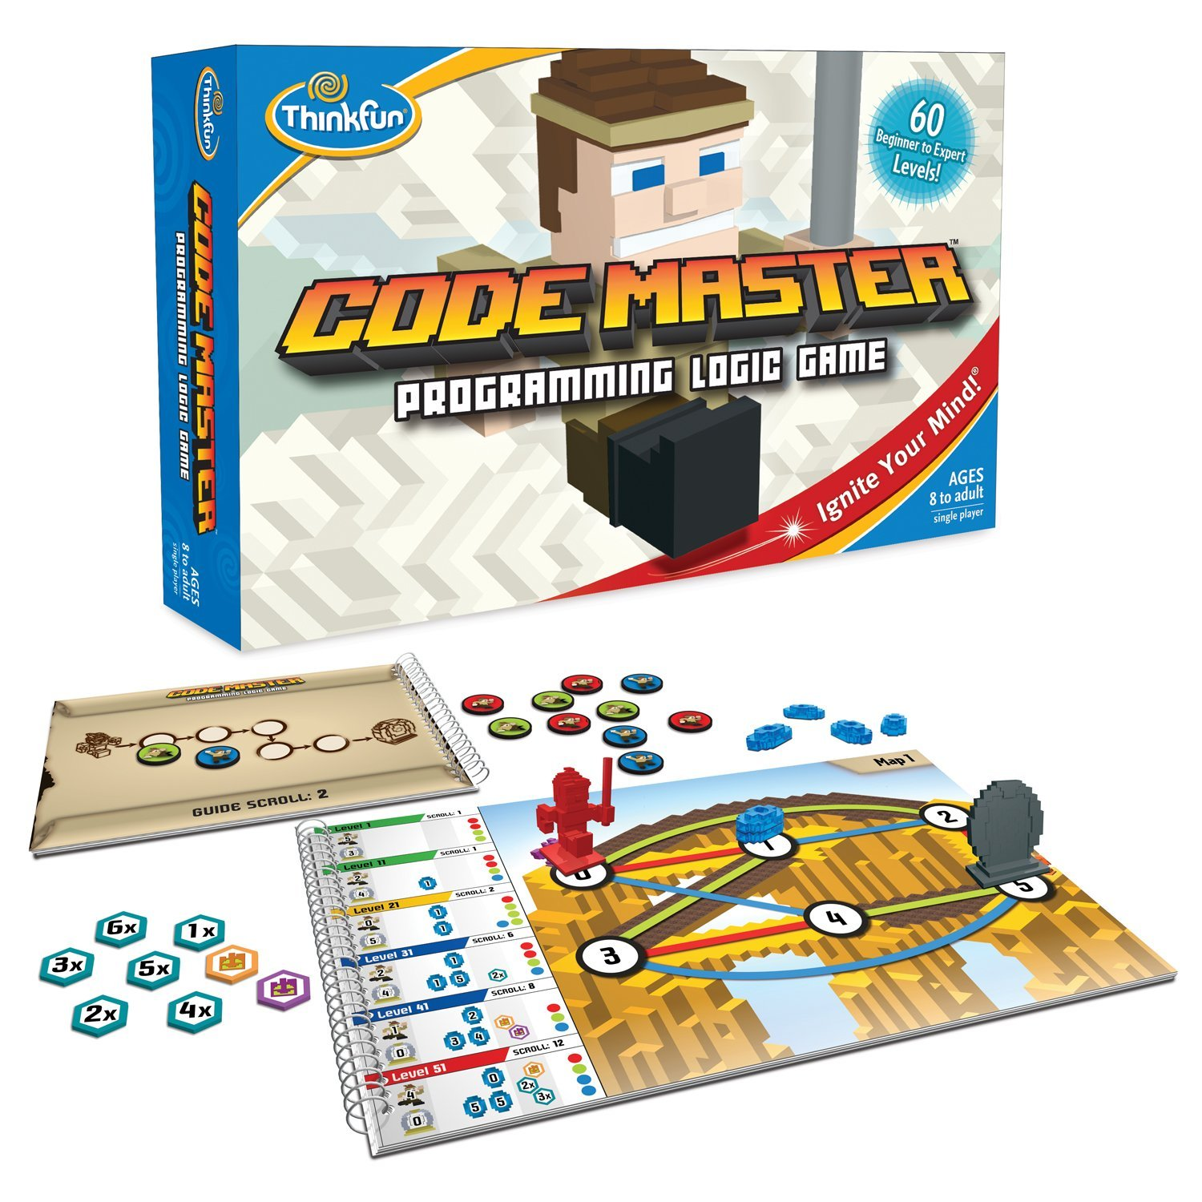
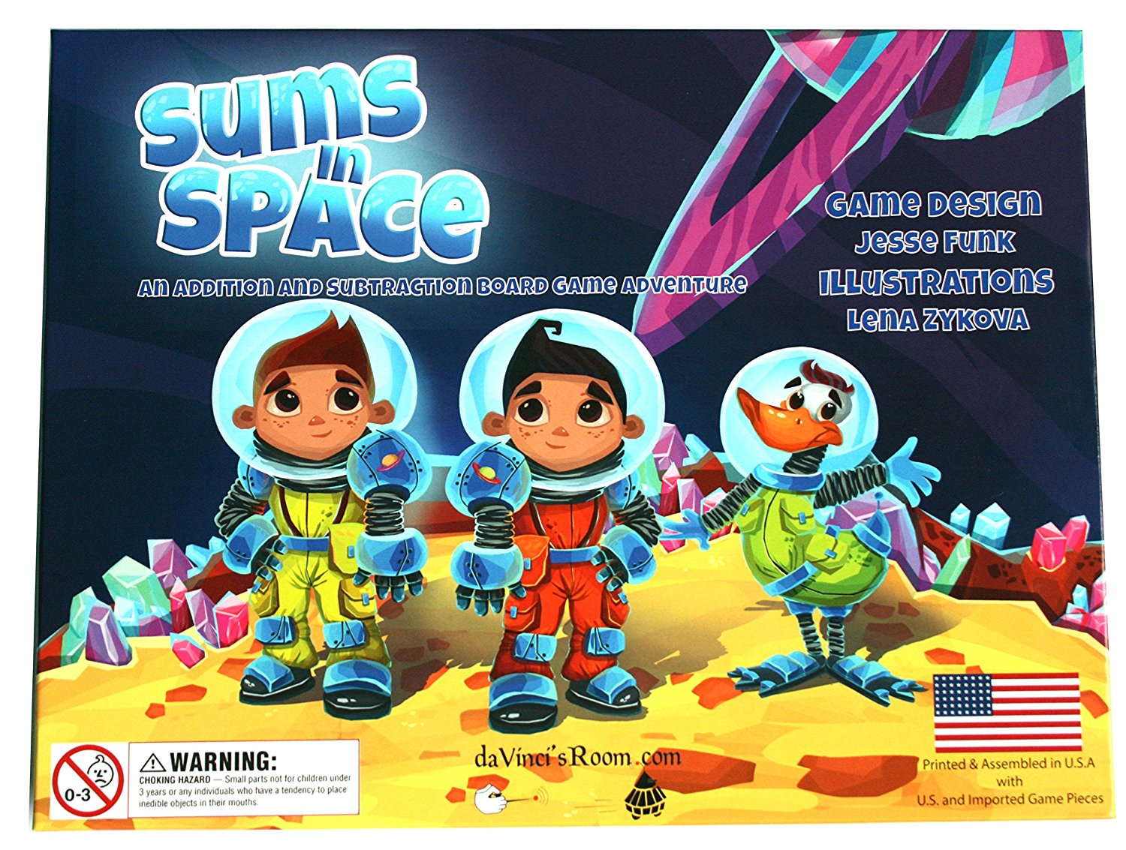
STEM Game Hands-On & Game Inventory
Come check out new games and help count pieces if you are able
  Next week: Tuesday the 26th, 8:30-10:30am

Slide 5
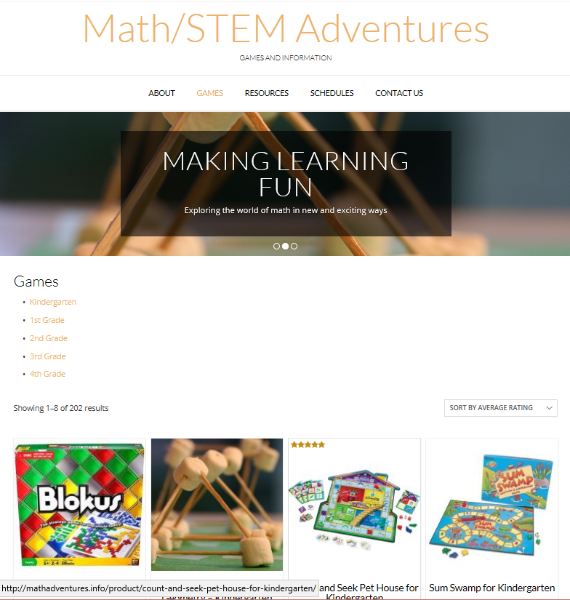
www.mathadventures.info www.stemadventures.info
Games by Grade and Category
  Instructions
  How-to videos
  Reviews/tips (No more binder reviews)
Math/STEM Adventures Program Information
Please review games after you play :)

Slide 6


Reminder about checking out games
If school is in session, the games should be at school. Game checkout is for after school hours only.

Slide 7

Before You Leave
Thanks for volunteering for
STEM Adventures!
Write the Class Coordinator/Lead's name on the Poster
Put the STEM Game Hands On/Game Inventory in your calendar (Next Tues 8:30-10:30am)
Make mathadventures.info a favorite site on your phone/computer
If you are new to the program go to the Art Room now for more information
Class Coordinator Job:
  Schedule days/times with Teacher
  Make sure your class has reserved the days/times on the shared space calendar
  Schedule volunteers for each session
  Help choose games as needed
  More info at: http://mathadventures.info/class-coordinator-information/

